Slide 1
Constructing the Graph using its Cycle Space and finding its branches uniquely
Group 10

Slide 2
Introduction
Spanning Subgraph
A spanning subgraph of G(V,E) is a graph g(V,E’) where |E’| <= |E| and E’ can contain any number of edges, even zero edges.
Eulerian Subgraph
An eulerian subgraph of G(V,E) is any subgraph g(V,E’) where |V’| <= |V| and |E’| <= |E| such that every vertex in V’ has even degree.

Slide 3
Cycle Space
It is the collection of all the eulerian spanning subgraphs in the Graph.
Branch
A branch is simply any edge present in the spanning tree of a graph.

Slide 4
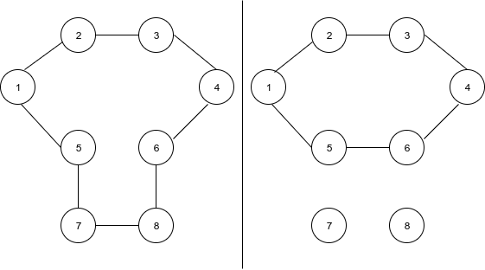
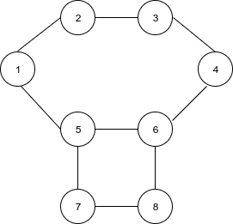
Given graph (G(V,E))
Two eulerian subgraphs for G(V,E)

Slide 5
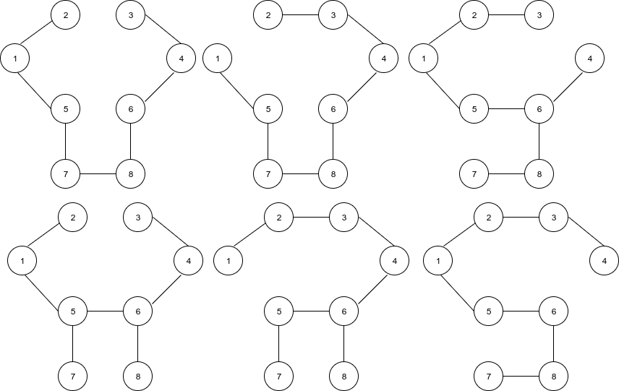
Fig. Some spanning trees for G(V,E)

Slide 6
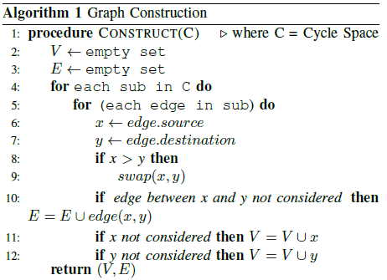
Approach { O(Log(V)*2E) }
For Graph Construction

Slide 7
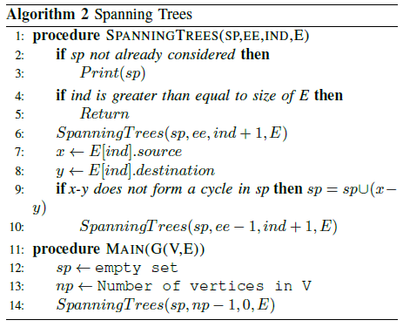
For Spanning Trees

Slide 8
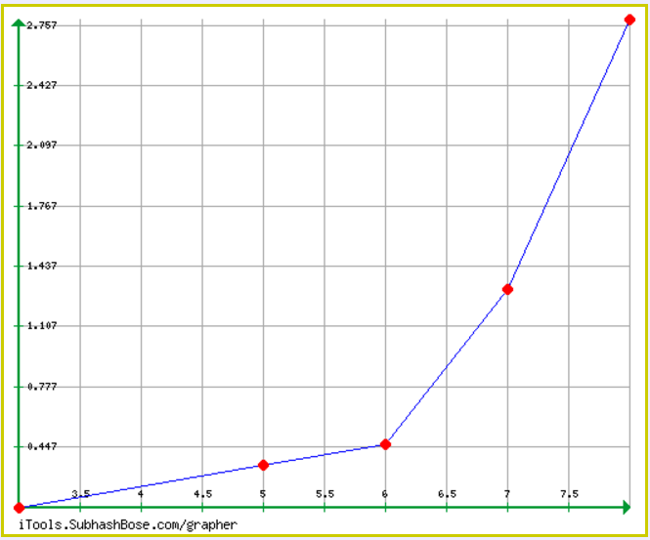
Number of Nodes vs Time Taken(ms) graph

Slide 9
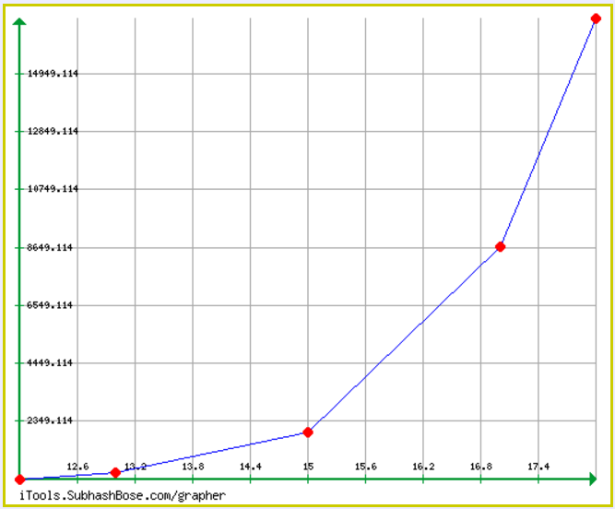
Number of Nodes vs Time Taken(ms) graph

Slide 10
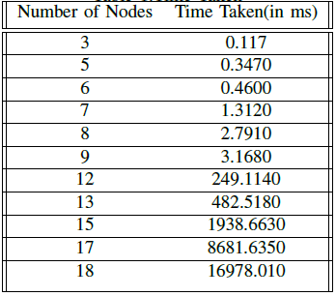
Table showing No. of nodes vs Time Taken

Slide 11
Conclusion
With the cycle space as an input, Original Graph has been constructed.
After constructing the Graph, we found the possible spanning trees recursively.
The Time Complexity of the proposed algorithm is O(Log(V)*2E).

